Slide 1
Babel OP3 System Deliveries
Fred Richardson, Michael Coury and Steven Feinstein
Babel OP3 Tech Transition Workshop
Feb 16, 2017

Slide 2
Overview
Babel OP3 T&E Status
Delivery and Baseline Systems and Requirements
System configurations
Performance measures
Obtaining the Systems

Slide 3
Current Babel Delivery
DELIVERY
 | BP | OP1 | OP2 | OP3
Practice Languages | Cantonese | Assamese | Cebuano | Amharic
 | Pashto | Bengali | Kazakh | Dholuo
 | Tagalog | Haitian Creole | Kurdish | Guarani
 | Turkish | Lao | Lithuanian | Igbo
 |  | Zulu | Telugu | Javanese
 |  |  | Tok Pisin | Mongolian
 |  |  |  | Pashto (revisited)
Surprise Language | Vietnamese 4 weeks | Tamil 3 weeks | Swahili 2 weeks | Georgian 1 week
Transcribed Training Data | FLP: 80 hours LLP: 10 hours | FLP: 60 hours LLP: 10 hours | FLP: 40 hours VLLP: 3 hours | FLP: 40 hours
Pron Lexicon | YES | YES | NO | NO
Channel Conditions | Mixed Env | Mixed Env | Mixed Env | Mixed Env
 | Telephone | Telephone | Telephone | Telephone
 |  | 2 Microphone | 2 Microphones | 7 Microphones
ATWV Target | 0.3 or greater | 0.3 or greater | 0.3 or greater | 0.6 or greater
WER Target | N/A | N/A | N/A | 50% or less
3

Slide 4
The Systems
Two types of systems:
Evaluation snapshot (Babelon and LORELEI)
Open source (Kaldi)
Deliveries (Babelon / LORELEI)
Developed specifically for OP3 Babelon
Not the full OP3 system which combines multiple sub-systems
No language specific pronunciation dictionary is used
Significant language specific configuration is required
Baseline (Kaldi)
Developed for general ASR tasks
Kaldi comes with over 40 recipes – one is for Babel
Babel recipe can run with or without a dictionary
Babel recipe requires limited language specific configuration

Slide 5
Baseline and Delivery Systems
Delivery System Components (Babelon and LORELEI)
Multi-lingual DNN training
Web scraping tool (LORELEI “Babler” from Columbia Univ)
Web LM training
Acoustic and language training and grammar building
Decoding and keyword spotting
Baseline System Components (Kaldi)
Acoustic and language training and grammar building
Decoding and keyword spotting

Slide 6
Current T&E Delivery Status
 | Kaldi | LORELEI | Babelon
Georgian Smoketest | N/A | ✓ | ✓
Pashto Training & KWS | ✓ | ✓
Javanese Training & KWS | ✓ | ✓
Web LM training | N/A
Multi-lingual DNN Training | N/A |  | ✓
Good progress so far evaluating systems
Iterative process of debugging deliveries
Final versions of systems will be ready by end of March 2017

Slide 7
Documentation
LORELEI has a detailed 15 page PDF
Babelon has a README and annotated config files
Kaldi documentation is on the web:
Web documentation: http://kaldi-asr.org/doc/
Online forums: http://kaldi-asr.org/forums.html
Significant learning curve for each system
Some dependencies to sort out (Perl and Python modules)
All systems use Sun Grid Engine (see Kaldi documentation!)
LORELEI and Babelon require some Babel specific expertise
Kaldi learning curve is more general (applies to all recipes)

Slide 8
General Requirements
There are a few common requirements for all systems
Systems only run on Linux
Standard interpreters: PERL and Python (2/3)
TIP: use “perlbrew” and “Anaconda”
Compute cluster running Sun Grid Engine
LORELEI and Babelon requirements handled in documentation
Kaldi dependencies handled in “tools” directory
Babel build packs for training systems
Web text for additional language model and lexicon building

Slide 9
Sun Grid Engine
All systems use Sun Grid Engine
Multi-node Linux compute cluster
Delivery systems run with 64 nodes concurrently
Details on configuring SGE can be found here:
http://kaldi-asr.org/doc/queue.html
Kaldi and Babelon require a separate GPU queue
Queue of machines with NVidia Tesla GPUs
LORELEI requires runs locally on machine with a GPU
Slight differences in SGE configurations
Kaldi and Babelon system have slightly different conventions
SMP name is different
LORELEI uses Lincoln “qexport” tool to run on SGE

Slide 10
Language Configuration
Kaldi system is relatively language independent
System can be built without dictionary (uses “morfessor”)
Slightly better performance using dictionary
Must specify if language uses Roman script
Babelon and LORELEI systems are language dependent
Require careful studying of LSP and Wikipedia
Generally require 2 mapping:
Letter to grapheme
Grapheme to phoneme
Require list of pronunciations for letters for acronyms
LORELEI uses a Python script with dictionaries and a feature file
Babelon uses UTF-8 text files
Creating language dependent configuration is tricky

Slide 11
Training and KWS
Kaldi
Used 64 compute nodes (6 Gig per node)
Training takes roughly a day
Decoding takes a few hours (very fast)
KWS takes 12 hours
Note that decoding and KWS are run 20 times (parameter sweep)
LORELEI
Training is run on single 16 core machine
Training takes roughly 1 day
Total KWS time is roughly 2.5 days on 40 machines (only run once)

Slide 12
Multi-lingual Bottleneck Features
LORELEI ML-DNN training
Runs on a single system using one GPU
Using all 24 languages requires 11 days (and 300 Gb of disk)
Requires a training run for each language (more than 24 days)
Fortunately a pre-trained ML-BNF model is provided
Babelon ML-DNN training
Smoke test provided for quick testing run on a single machine
Uses a SGE GPU cluster – multiple GPUs can be used for training

Slide 13
Web Data LM
Babelon and LORELEI deliveries include Web LM tools
LORELEI web scraping tool available from Columbia University
Web text for Georgian is available from NIST
Other languages web data is not currently distributed
The web tools generally run in three stages:
A normalization step that puts the data into a standard form
A language identification step that remove non-target language data
A language model training step that builds an LM and a lexicon
The normalization requires language dependent configuration

Slide 14
Javanese and Pashto Performance
Full Babel OP3 systems have ATWV > 0.6 and WER < 50%
Delivery is not full system – ATWV is lower
Results are given for dev data set use dev keyword list
Pashto systems trained with 80 hours of transcribed data
Javanese uses 40 hours of transcribed data (80 hours total)
None of the systems use Web text LM or lexicon
Lincoln attempted to create the language mapping files
Some success for LORELEI system (system ran)
Didn’t succeed with Babelon system
Note required for Kaldi system
Lincoln also used mapping files included with deliveries

Slide 15
Javanese Comparison
Javanese Performance:
Pashto Performance:
System | ATWV | WER
Kaldi (with dictionary) | 0.408 | 55.3%
Kaldi | 0.378 | 56.4%
LORELEI (Lincoln Config) | 0.336 | 62.8%
LORELEI (IBM Config) | 0.350 | 62.7%
System | ATWV | WER
Kaldi (with dictionary) | 0.571 | 43.4%
LORELEI (Lincoln Config) | 0.395 | 54.0%

Slide 16
Babel System Transition
Progress will continue on T&E of deliveries through March
Lincoln will provide feedback to POCs for final deliveries
Babel final system delivery (included): Babelon and Lorelei
Further development of the above two systems will require establishing the contractual relationships with IBM and Raytheon BBN, respectively.
Babelon system: Lorelei system:
POC: Dr. Stavros Tsakalidis POC: Dr. BrianKingsbury
email: Stavros@bbn.com email:bedk@us.ibm.com
617-873-4976 (office) 914-945-2541 (office)
617-378-7838 (cell)
16
Notes:
Classification
Classification
16

Slide 17
Babel System Transition
NOT Included in Babel final system delivery:
Kaldi Open Source Toolkit:
POC: Dr. Sanjeev Khudanpur
email: khudanpur@jhu.edu
410-516-7024 (office)
PySpeech system (Tech Transfer Sharing Agreement with NSA):
POC: Mr. Dave Farris/Mr. Jeff Farris
email: dcfarri@tycho.ncsc.mil;jjfarr2@tycho.ncsc.mil
301-688-9289/301-688-9172
“Babler” web scraping tool
POC: Gideon Mendels
email: gm2597@columbia.edu
17
Notes:
Classification
Classification
17

Slide 18
Babel System Transition
MOU (Memorandum of Understanding) with IARPA must be in place to acquire Babel systems.
POC for MOU:
Primary: Dr. Carl Rubino (Babel PM)
email: carl.rubino@iarpa.gov
301-851-7563 (office)
Secondary: Dr. Lee Knauss (Chief Technology Transition)
email: lee.knauss@iarpa.gov
301-851-7475 (office)
POC for System Access (till March 31, 2017):
Mr. Frederick (Fred) Richardson
email: frichard@ll.mit.edu
781-981-3626 (office)
18
Notes:
Classification
Classification
18

Slide 19
Babel System Transition Steps
IARPA currently has Umbrella MOUs with ARL,CIA and NRO. Other agencies are still in progress.
For agencies with Umbrella MOU, an Annex for Babel program will prepare for you to sign.
Once MOU (or Annex) is signed by both parties, IARPA will provide you a link to download software packages from Inteldoc (Passport or CAC login is required).
For those who don’t have access to Inteldoc, IARPA will ship you the hard disk to a designated physical address. Please contact Babel PM Dr. Carl Rubino for this arrangement.
19
Notes:
Classification
Classification
19

Slide 20
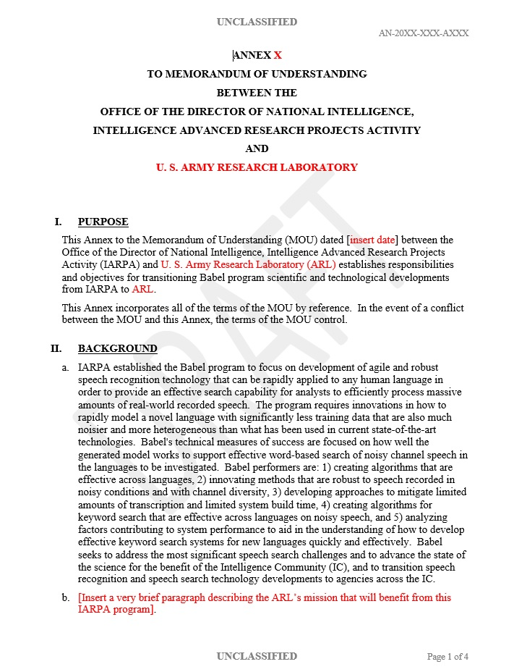
A Sample Copy of MOU Annex
20
Notes:
Classification
Classification
20

Slide 21
Babel Data Agreement
A separate data agreement needs to sign and specify the Babel program datasets.
The datasets consist of 25 Babel languages, each with a LSP (Language Specific Peculiarities Document) and a Build Pack – may pick and choose the ones you need.
Build Pack is the Babel language data (not the raw data) that the Babel performers/volunteer teams used to train and develop their systems.
Once the agreement is signed by both parties, an URL (with user ID and password) will be provided to download the datasets.
21
UNCLASSIFIED
Notes:
Classification
Classification
21

Slide 22
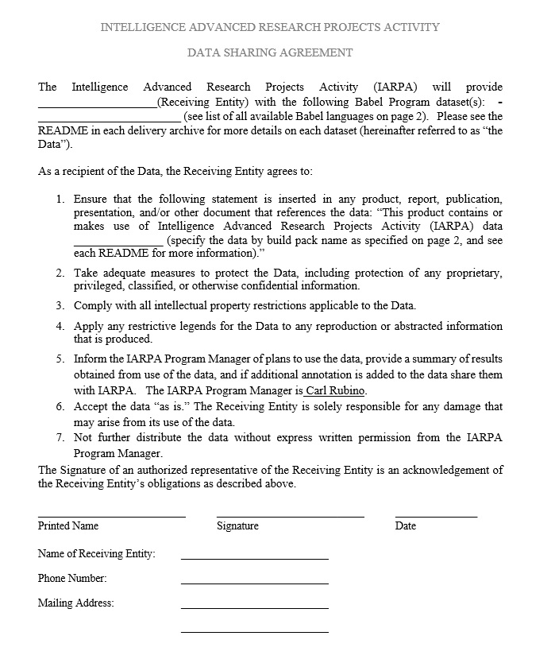
Babel Data Agreement
POC for Data Agreement:
Primary: Dr. Carl Rubino
email: carl.rubino@iarpa.gov
301-851-7563 (office)
Secondary: Dr. Lee Knauss
email: lee.knauss@iarpa.gov
301-851-7475 (office)
22
Notes:
Classification
Classification
22

Slide 23
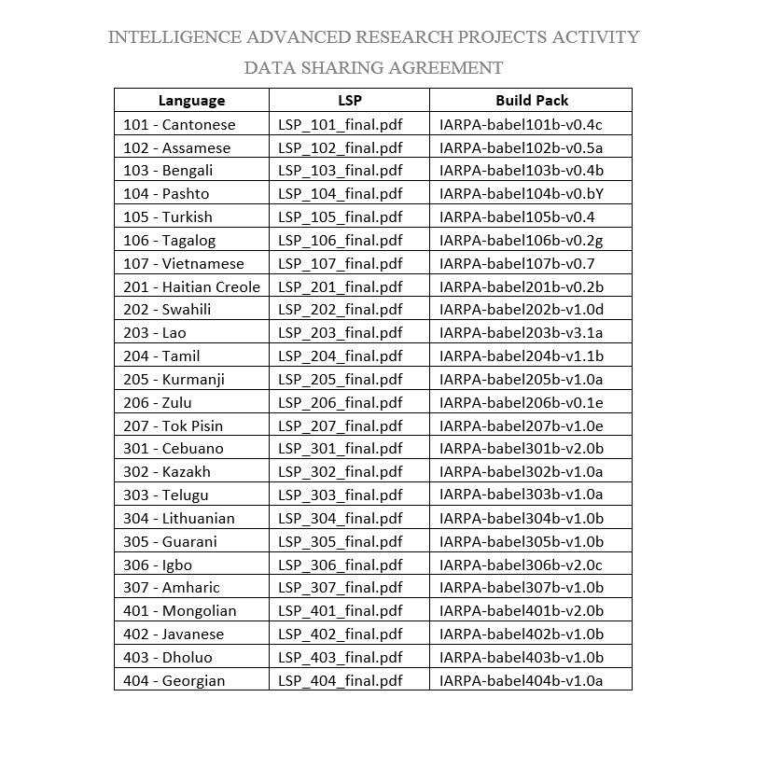
List of Babel Build Packs
23
UNCLASSIFIED
Notes:
Classification
Classification
23

